Slide 1

WEIGHTRON
OPTIMIZING COAL LOADING FOR EFFICIENT RAIL TRANSPORT: ADDRESSING OVERLOADING AND UNDERLOADING CHALLENGES
RESHMI T III/EEE
KEERTHIKA G III/ECE
SRICHARAN III/ICE
SRINIVASAN III/AIDS
TRANSPORTATION AND LOGISTICS
SRI SAIRAM ENGINEERING COLLEGE

Slide 2
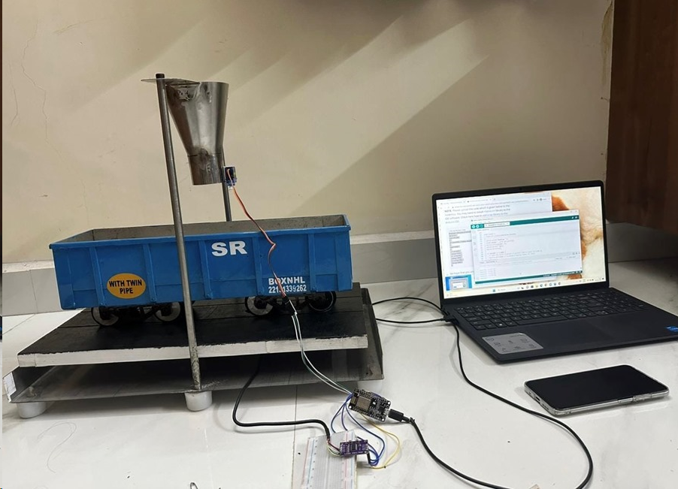
OVERVIEW
01
02
03
PROBLEM STATEMENT
IDEA OVERVIEW
ARCHITECTURAL DIAGRAM
04
05
06
CONTROL PANEL
FUTURE SCOPE
DOCUMENTATION

Slide 3
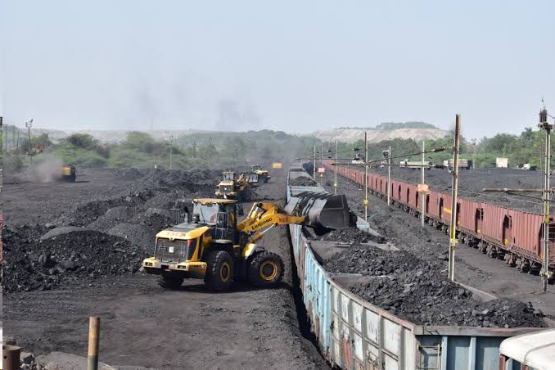


PROBLEM STATEMENT
A System of IOT devices to prevent Underloading or Overloading of railway wagons.
The goal is to transcend conventional transportation models and design innovative systems that enhance the liveability of cities while efficiently moving goods, whereas CIL has experienced significant financial losses due to difficulties in wagon loading, including fines for overloading and additional expenses from under loading, which exceed the actual contract value of Rs. 593 Crores in 2021-2022.

Slide 4




SUSTAINABLE DEVELOPEMENT GOAL
09
INDUSTRY INNOVATION AND INFRASTRUCTURE
11
SUSTAINABLE CITIES AND COMMUNITIES
12
RESPONSIBLE CONSUMPTION AND PRODUCTION

Slide 5
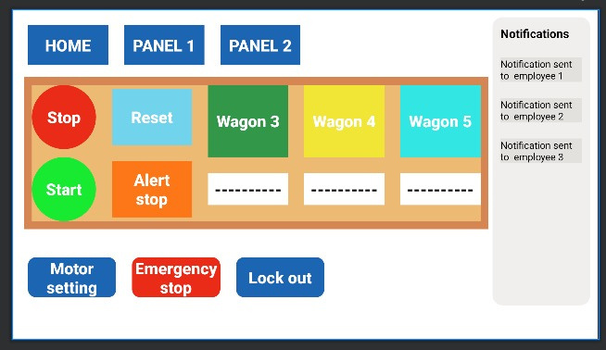

IDEA OVERVIEW
Installing load cell, under the surface of the track to continuously measure the weight of the wagon.
Equipping wagon with IoT communication modules to transmit weight data in real-time to a centralized control system, ensuring immediate monitoring and signal is passed to servo motor once the maximum weight is reached.
Integrating an alerting mechanism within the central control system to detect under-loading or overloading. When such conditions are identified, immediate alerts are generated and transmitted to Coal India Limited.

Slide 6

MARKET PROSPECTS
As cities grow, the demand for efficient and sustainable urban mobility solutions rises. The market for innovative transportation systems that enhance urban liveability is expected to expand significantly.
Urban Mobility Growth
IoT and Smart Transportation
IoT-based solutions for railway wagon load monitoring and urban mobility align with this trend, presenting substantial market potential.
Urban residents and businesses increasingly demand convenient, sustainable, and efficient transportation options. Meeting these demands creates market opportunities
Consumer Demand
As market demand grows, there will likely be increased competition and innovation, leading to a broader range of transportation solutions and improved technologies.
Competition and Innovation

Slide 7

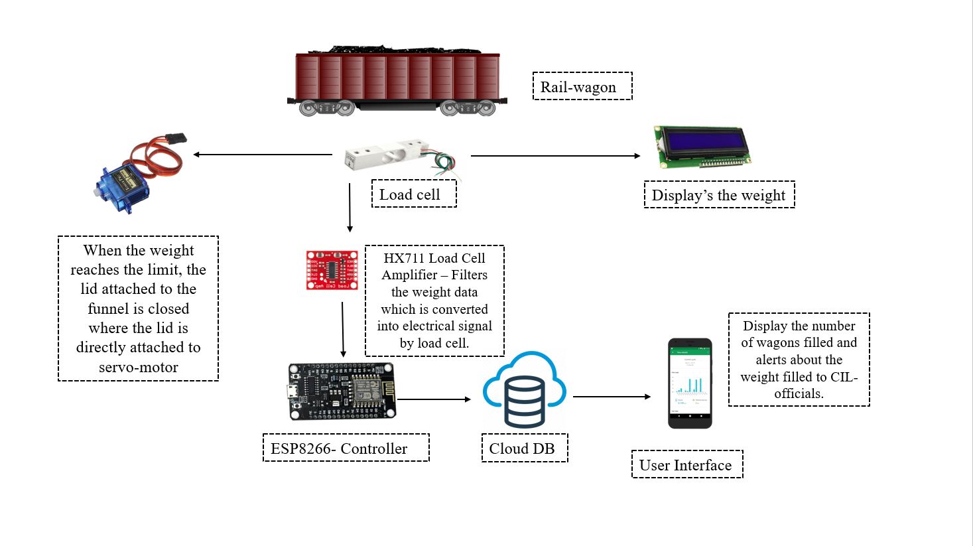
ARCHITECTURAL DIAGRAM

Slide 8
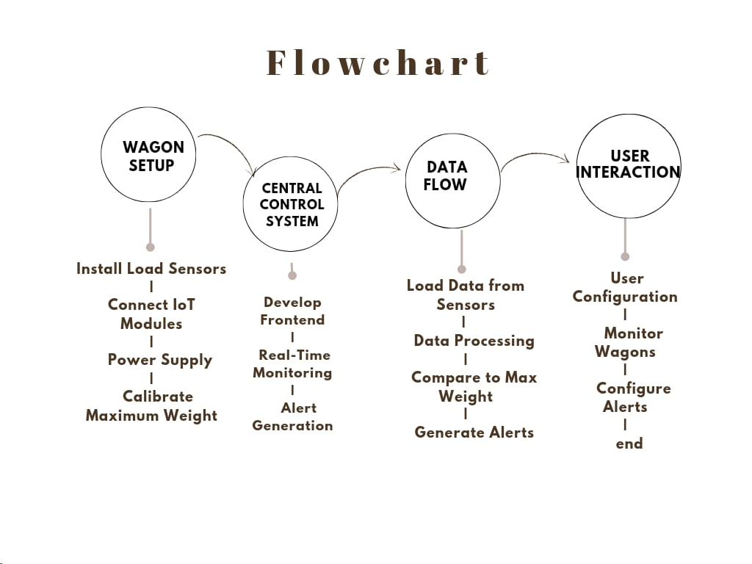
FLOWCHART

Slide 9


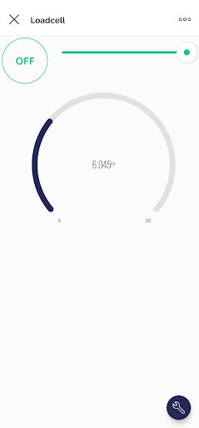
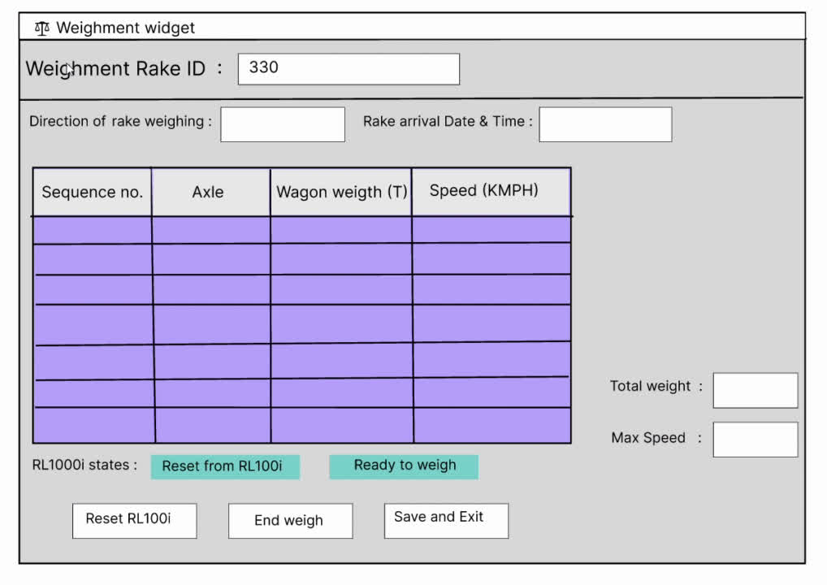



CONTROL PANEL

Slide 10

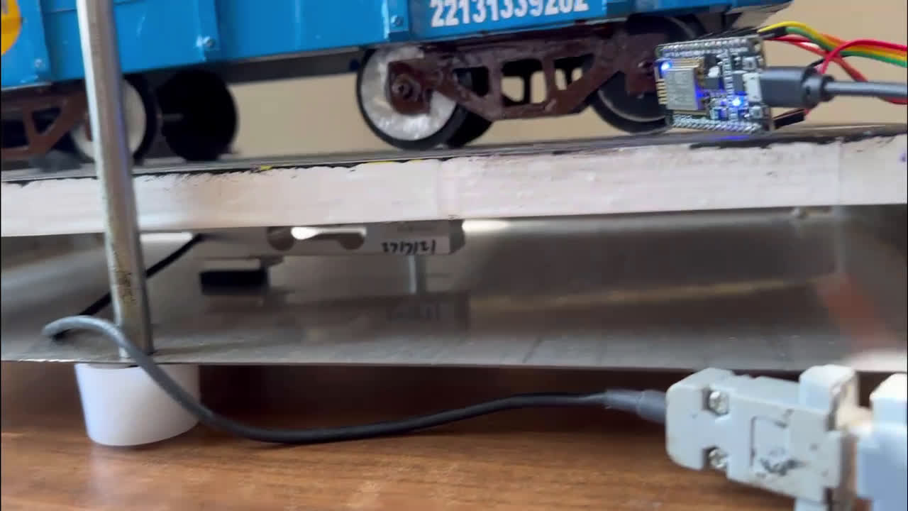
PROTOTYPE WORKING

Slide 11
FUTURE SCOPE
Ongoing advancements in IoT, AI, and data analytics will further enhance the accuracy and efficiency of transportation systems.
Future solutions will prioritize environmental sustainability, reducing emissions and environmental impact.
Transportation systems will become more user-centric, offering personalized and convenient mobility options.
The integrated approach has global relevance, with opportunities to address transportation challenges in diverse regions
Future scope involves seamlessly integrating various modes of transportation to provide efficient and convenient travel for both goods and people.

Slide 12
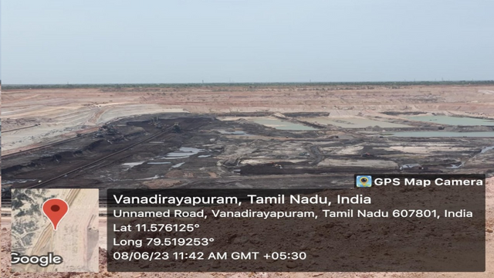
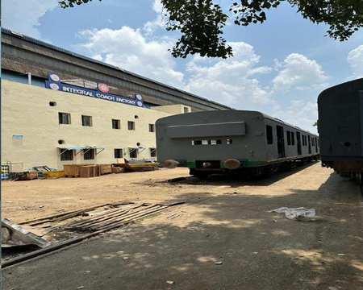
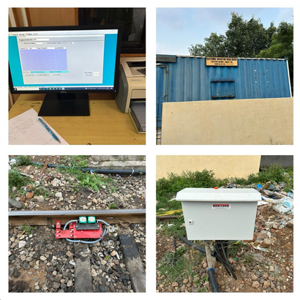



DOCUMENTATION AND INDUSTRIAL REFERENCE
INTERN AT NEYVELI LIGNITE CORPORATION INDIA LTD
2. INTERN AT INTEGRAL COACH FACTORY
3. VISIT TO ELECTRONIC INMOTION AMBATTUR
RESOURCE PERSONS
Bala C M TS
Kapaldurai G Chief Manager Mine 1A
RESOURCE PERSONS
PARTHASARATHY, Shop 30 general SSC,
N. GAJARAJ B Shop Shell Division Integral Coach Factory
RESOURCE PERSONS
K.BALA KRISHNA principal consultant in ECSADM

Slide 13







OUR TEAM
KEERTHIKA G
T RESHMI
SRICHARAN K
SRINIVASAN N
STREAM: ECE
STREAM: EEE
STREAM: ICE
STREAM: AIDS

Slide 14
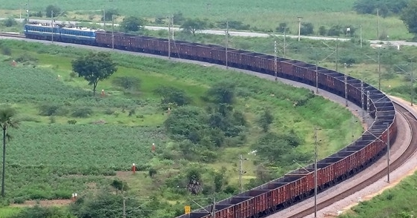
THANKYOU

